Slide 1

Intro to resilience modelling, simulation, and visualization in Python with fmdtools
Author: Daniel Hulse

Slide 2
Overview/Prerequisites
Overview of fmdtools
Purpose
Code structures
Methods
Syntax
Coding Activity
Example model
Workbook
Model Instantiation
Simulation
Visualization/Analysis
Download Slides:
github.com/DesignEngrLab/fmdtools/tree/main/docs
Right click “Save link as…”
You need a Python distribution!
(preferable Anaconda)
https://www.anaconda.com/products/individual

Slide 3
Why model system resilience?
We want to know how the system will respond to hazardous events, to:
Reduce unforeseen maintenance/repairs
Ensure system safety
Check that system behavior will be robust to unforeseen events
In a hazardous scenario:
Will the system fail to a safe condition?
Will it recover?
Or, will it wreak havoc on itself and the environment?

Slide 4
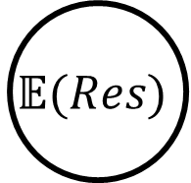
What is resilience?
Prevention
Recovery
Nominal Scenario
$$\text{𝔼}(Res)$$
Nominal Performance
Hazard
Expected
Resilience:
Resilience over a set of hazardous scenarios
Recovery
Resilience
No Recovery
Faulty Performance
Fault Time
Yodo, N., & Wang, P. (2016).

Slide 5
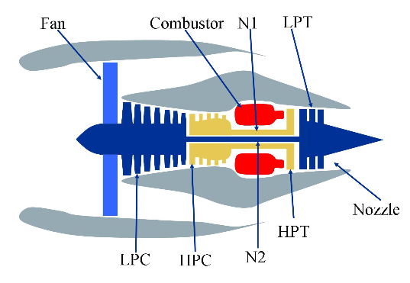
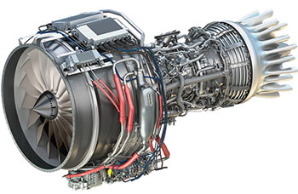
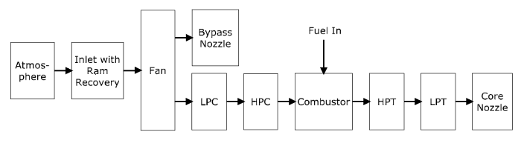
Why use resilience in design?
Concept Design
Embodiment Design
Implementation
Reactive
Design
Choose concept
Design system
Retrofit for resilience
?
?
?
?
So we can make the system resilient-by-design
Proactive
Design
Establish resilience approach
Integrate resilient features in design
Verify resilient function
?
?
✔
✔
S3
?
?
?
✔
S2
✔
S1
Image 1 & 2 Credit: User’s Guide for the Commercial Modular Aero-Propulsion System Simulation (C-MAPSS)
Image 3 Credit: https://en.wikipedia.org/wiki/File:General_Electric_Passport.jpg

Slide 6
Why fmdtools? Why not an existing tool?
Uncertainty Quantification tools: (e.g. OpenCossan)
Doesn’t incorporate fault modelling/propagation/visualization aspects
MATLAB/modelica/etc. Fault Simulation tools
Rely on pre-existing model/software stack
Useful, but often difficult to hack/extend
Safety Assessment tools: (e.g. Alyrica, Hip-Hops)
Focused on quantifying safety, not necessarily resilience
(though they are related)
Different model formalisms!

Slide 7
Why fmdtools?
Expressive:
Undirected graph propagation
faults from any component can propagate to any other connected component
General model representation—not a strict formalism
Behavioral (equations), fault logic (if-else statements), etc.
Dynamic simulation needed to quantify resilience
Research-oriented:
Written in/relies on the Python stack
Open source/free software
Enables design:
Models can be parameterized an optimized!
Provides tools to visualize and quantify simulation results

Slide 8
Why not fmdtools?
Limitations:
Deterministic modelling paradigm
no ability to model non-deterministic behaviors
Doesn’t work with existing models in different software
no integration with Simulink, modelica, etc. system models
Not targeted for safety/fault tree calculation
It’s research code!

Slide 9
What is fmdtools?
A modelling framework
Simulation methods
Visualizations/Metrics
…
A design environment

Slide 10
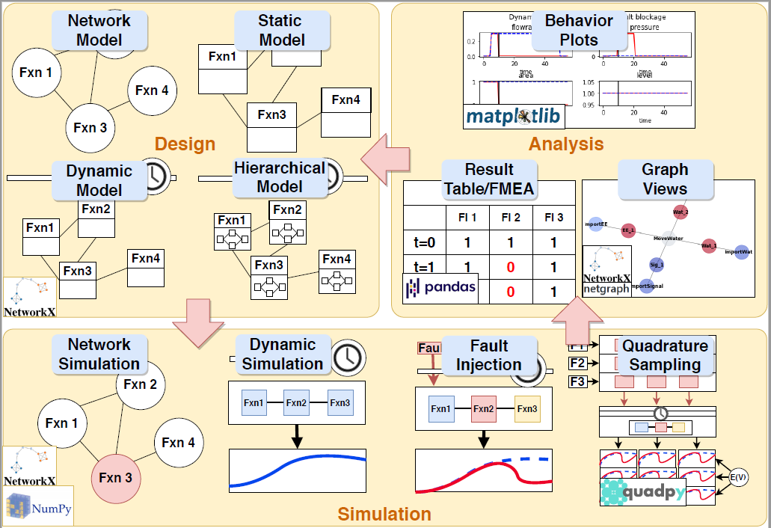

Slide 11
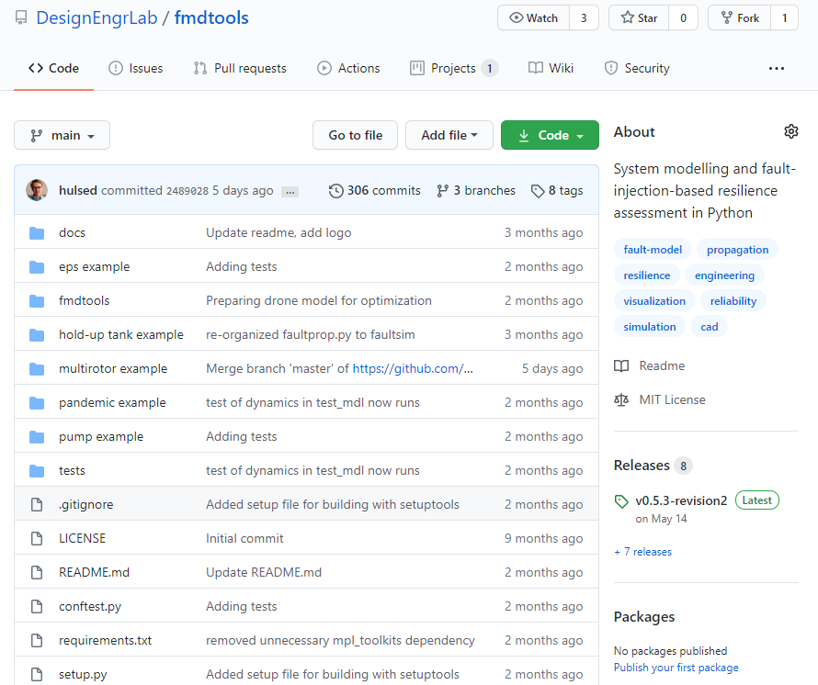
GitHub Repository
github.com/DesignEngrLab/fmdtools
/fmdtools – toolkit modules
/XX example – example models
Documentation in /docs, readme, examples
Toolkit modules also available from PyPl
(e.g. pip install fmdtools)

Slide 12
Activity: Download and Install fmdtools
Make sure Python environment is installed
e.g. https://www.anaconda.com/products/individual
Install fmdtools from PyPl:
pip install fmdtools
Download workbook files from Github repository
https://github.com/DesignEngrLab/fmdtools
Navigate to /pump example
Right Click Tutorial_unfilled.ipynb and click “Save Link As” to download
Right Click ex_pump.py and click “Save Link As” to download to your computer
Open the notebook and model!

Slide 13
Structure: /fmdtools
Design
Simulation
Analysis
modeldef.py
Model class: representation of model functions, flows, behaviors, faults, etc.
Function class
Flow class
Component class
…
SampleApproach class: defines set of fault scenarios to represent the statistical expectation of resilience
/faultsim
/resultdisp
networks.py
Quantification and visualization of metrics using a network model represtenation
process.py
Processing of simulation results into metrics/statistics
plot.py
Plotting of system behaviors and costs over time
propagate.py
Propagation of model behaviors in nominal and faulty scenarios
nominal()
one_fault()
singlefaults()
approach()
graph.py
Visualization of simulation results on the model graph
tabulate.py
Display and export of simulation results as tables

Slide 14
A typical work-flow
Define model: System.py
Model Class:
Run parameters
Function/flow connections
Effects Classification
Function/Component Classes:
States
Behaviors
Simulate, visualize process model: Script.py or Notebook.ipynb
Model instantiation (e.g. mdl = Model())
Behavior simulation
propagate.nominal(mdl), propagate.one_fault(mdl, fault) …
Results processing and visualization
graph.show(mdl), plot.mdlhistvals(mdlhist) …
tabulate.hist(mdlhist), tabulate.simplefmea(endclasses)…
System
SampleApproach
Model, FxnBlock, Component
modeldef.py
/faultsim/propagate.py
/resultdisp/plot.py
/resultdisp /graph.py
…

Slide 15
Defining a model
What do we want out of a model?
What functions/components and how much fidelity do we need?
Network or behavioral?
Dynamic or static?
Functions or component architectures?
Behaviors or failure logic?
What can go wrong? What are the faults/events?
What are the possible effects and how bad are they?

Slide 16
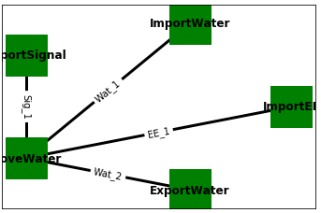
Demonstration Model - Pump
/pump example/ex_pump.py
Functions: (nodes)
Define behaviors, and faults of the of the system
e.g. ImportSignal, ImportWater, MoveWater, ExportWater, ImportEE
Flows: (edges)
Define the connections between functions of material, energy, signal, etc.
e.g. Sig_1, Wat_1, EE_1, Wat_2

Slide 17
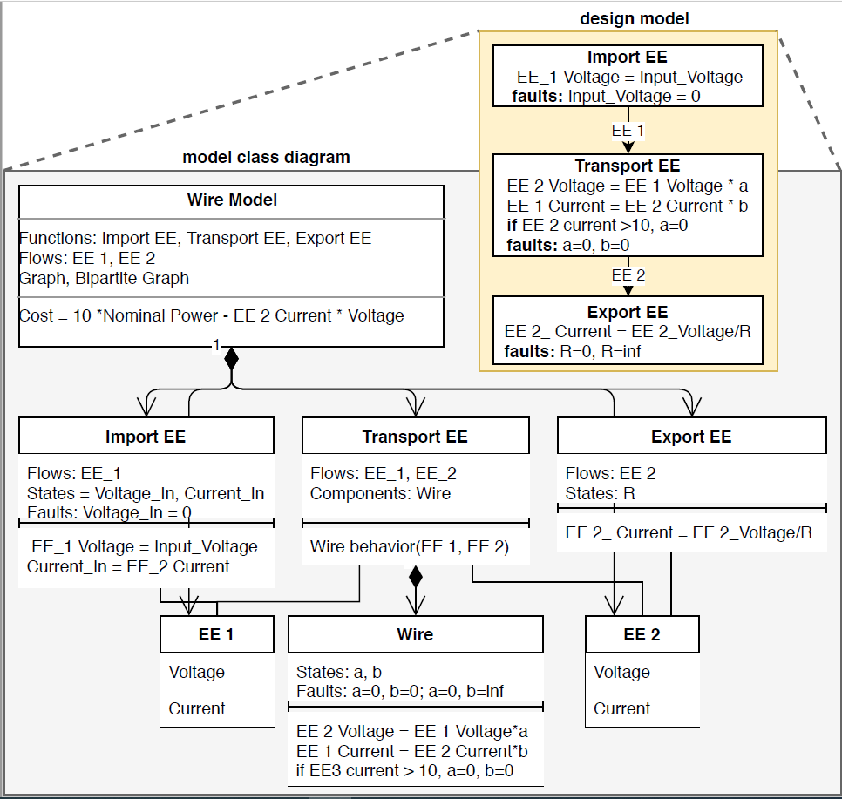
Model structure
Function Classes
Behaviors (I/O relationships)
Faults (modes, probabilities)
States (variable values)
Failure logic (fault effects)
Relationships to flows and components
Component Classes
Similar to function classes, but no access to flows outside of function
Model Class
Function/Flows
Function/flow objects
Graph of connections
Run parameters
Time, phases, units, etc
Classification Method
Method for determining fault effect costs
Flows
State Dictionary
EE = {voltage: 1.0, current:1.0}

Slide 18
Defining a model – generic code
from fmdtools.modeldef import Model, FxnBlock
class System(Model):
def __init__(self, params={})
super.__init__(params=params, modelparams = {phases, times, timestep})
self.add_flow(flowname, {value1:initvalue, value2: initvalue} …
self.add_fxn(functionname, [list of flows], fclass = DoSomething) …
self.construct_graph()
def find_classification(self,resgraph, endfaults, endflows, scen, mdlhists):
(anything)
return {‘rate’:rate, ‘cost’:cost, ‘expected cost’=expected cost
(imports)
(defining model class for system)
(model initialization method)
(define run parameters)
(define model flows)
(add and connect functions)
(form model graph)
(define how to classify model results)

Slide 19
Defining functions – generic code
(Define class for DoSomething function)
Class DoSomething(FxnBlock):
def __init__(self, flows):
super.__init__([flownames],flows,{state1: initval}, …)
self.failrate = failrate
self.assoc_modes({mode1:[proportion,[phases],repcost]})
def condfaults(self, time):
if self.flowname.val1 > threshold: self.add_fault(‘mode1’)
def behavior(self, time)
if self.has_fault(‘mode1’): self.flowname.val2 = 0
else: self.flowname.val2 = 1
if time>self.time:
self.state1 = self.state1 + self.flowname.val2
(initialization method (can also be used to pass parameters))
(add/associate model constructs:
flows, states, timers, components)
(Define faults and probability model)
(optional method for failure logic)
(function enters fault mode under given condition)
(method for system behavior)
(different modes change behaviors)
(dynamic behaviors are placed in an if time>self.time statement)
(accumulation of a state over time)

Slide 20
Activity: Open and instantiate pump model
Review code:
See pump code defining the Pump model class
See pump code defining MoveWater function class
Open tutorial notebook
Tutorial_unfilled.ipynb
Instantiate the model
mdl = Pump()
Explore
Try different parameters! Change things!
What does the model directory look like? dir(mdl)

Slide 21
Fault Simulation and Propagation
What are we trying to model:
The nominal performance of a system?
The performance in a fault scenario?
The performance over a set of fault scenarios?
What kind of set?

Slide 22

What if we want to quantify resilience
Prevention
Recovery
Nominal Scenario
Simulate Nominal Performance
Expected
Resilience
$$\text{𝔼}(R)$$
Nominal Performance
Simulate Fault Scenario Performance
Hazard
Simulate Performance Over Set of Fault Scenarios
Recovery
Resilience
No Recovery
Faulty Performance
Fault Time
Yodo, N., & Wang, P. (2016).

Slide 23
Fault propagation – how it works
Static propagation: How function states propagate to each other in a single time-step
Undirected graph representation—states can effect all other connected states, and vice versa, in any order
Dynamic propagation: How model states unfold over time

Slide 24
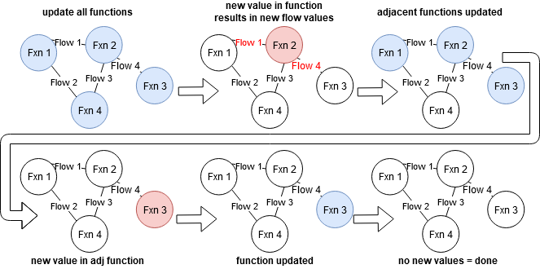
Static Fault Propagation

Slide 25
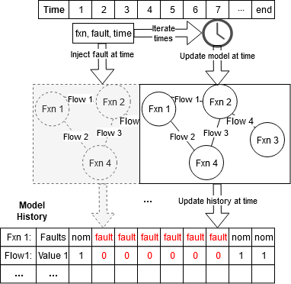
Dynamic Fault Propagation

Slide 26
Behavioral Propagation Methods
propagate.nominal(mdl)
Simulates system with no fault—good for model setup
propagate.one_fault(mdl, function, fault, time=faulttime)
Simulates system with and without a fault
Good for verifying/visualizing model behavior under a given fault
propagate.single_faults(mdl)
Simulates the list of single fault modes
Only use for static (single time-step) models & to gauge fault severity
propagate.approach(mdl, app)
Simulates a set of fault modes over a set of times
Useful for expected resilience quantification
app defined in SampleApproach class

Slide 27
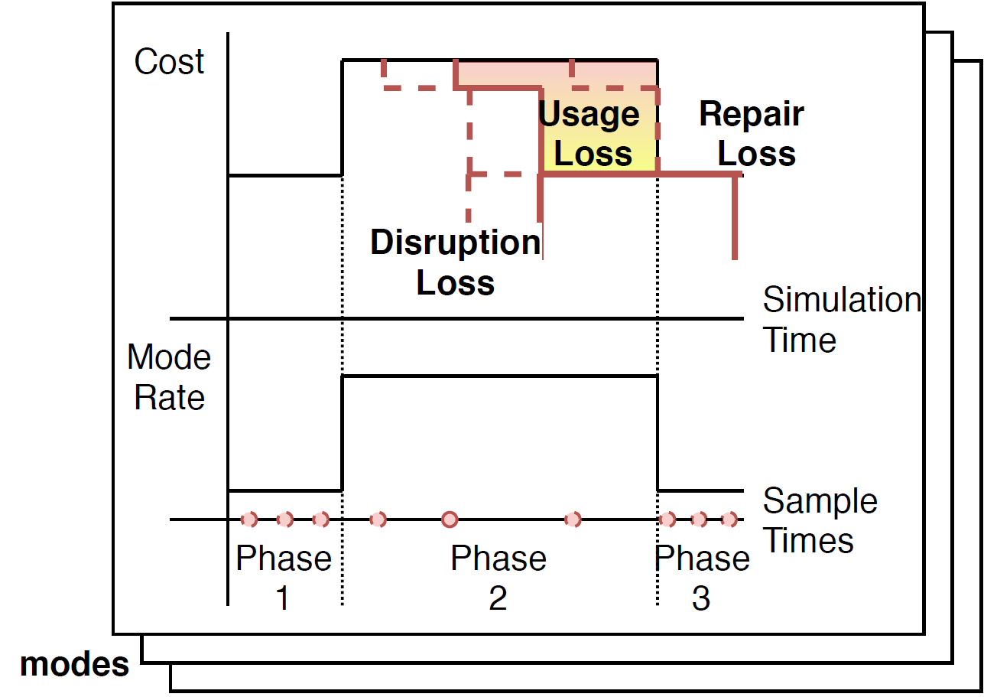
Propagation of a fault approach
Goal: Quantify expected resilience over a set of fault modes and operational phases
What times—all? 1-2? Several?
What modes—all modes? A selection of modes? Joint fault modes?

Slide 28
Propagation of a fault approach
app = SampleApproach(mdl,
faults = ‘all’/[list of faults]
phases = ‘all’/{fxn:phase:[s,e]}
modephases = {fxn:mode:{phases}}
jointfaults = {‘faults’:#,
‘jointfuncs’:True/False
‘pcond’: 0.##}
defaultsamp: = {‘samp’: ‘quad’/’fullint’/’evenspacing’…
‘numpts’: #
‘quad’: quadrature}
sampparams = {(fault, mode): sampparam}
(faults to include in the list)
(phases of each function to include (if model has phases))
(how function modes correlate to phases)
(Number of joint-fault modes to simulate (e.g. None, 2,3,..))
(Whether function modes are mutually exclusive)
(Conditional probability for joint faults (ind. by default))
(how to represent phases)
(Number of samples to take in each phase)
(If a quadrature is used, the quadpy object)
(If a different approach is to be used for each fault, sampparam follows the defaultsamp structure)

Slide 29
Activity: Propagate faults in the model
Run fault propagation methods:
Nominal
Fault(s)
Approach
What do the results look like?
endresults, resultshist, etc
Explore:
What happens when you change SampleApproach parameters?
What happens when you change model parameters?
How do these methods compare in terms of computational time?

Slide 30
Visualization, Quantification, Processing
Looking at a model
Looking at modelled quantities
Quantifying resilience
Saving/exporting results, etc

Slide 31



/resultdisp
process.py
Processing of simulation results into metrics/statistics
-hists(mdlhists)/hist(mdlhist): processes result history for fmea/visualization
-heatmaps(reshist), etc: creates heatmap of respective quantities over time/runs
-totalcost(endclasses): calculates total expected cost
plot.py
Plotting of system behaviors and costs over time
-mdlhist/mdlhistvals(mdlhist):
Plots behavior of given states over time in a given faulty and nominal scenario
-samplecost(app, endclasses):
Plots costs and rates of a set of faults injected over time in an approach
-costovertime(endclasses,app):
Plots the total expected cost of faults over time
graph.py
Visualization of simulation results on the model graph
-set_pos(graph):
Manually positions of functions/flows in graph
-show(mdl/graph):
Show graph at end-state
-history(graphhist):
Shows set of graphs over given history
-result(s)_from(mdl, reshist, t)
Shows model state at a particular time(s)
-animation_from(mdl, reshist,t)
Animates model states over given times
tabulate.py
Display and export of simulation results as tables
-hist(mdlhist): Gives table of the history of model states.
-deghist(mdlhist, withstats): Gives table of all degraded functions and flows over time
-heatmaps(heatmap): Displays heatmap dictionary in tabular form
-simple/phase/sum/fullfmea():
Gives FMEA-like assessment of the effects of faults/scenarios and their probability and costs
Netgraph

Slide 32
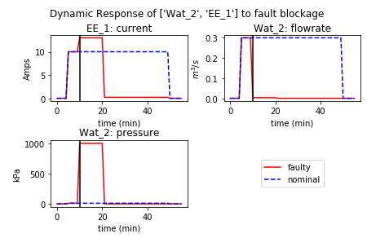
plot.py
plot.py
Plotting of system behaviors and costs over time
-mdlhist/mdlhistvals(mdlhist):
Plots behavior of given states over time in a given faulty and nominal scenario
-samplecost(app, endclasses):
Plots costs and rates of a set of faults injected over time in an approach
-costovertime(endclasses,app):
Plots the total expected cost of faults over time
Example Syntax:
rd.plot.mdlhistvals(mdlhist, ‘faultname’,
time=faulttime,
fxnflowvals={‘Flow1':[‘val1', ‘val2'],’flow2’:’val1’},
cols=2, timelabel="time (min)")

Slide 33
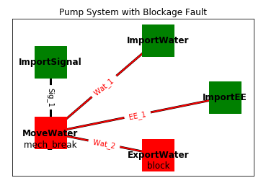
graph.py
graph.py
Visualization of simulation results on the model graph
-set_pos(graph):
Manually positions of functions/flows in graph
-show(mdl/graph):
Show graph at end-state
-history(graphhist):
Shows set of graphs over given history
-result(s)_from(mdl, reshist, t)
Shows model state at a particular time(s)
-animation_from(mdl, reshist,t)
Animates model states over given times
Example Syntaxes:
rd.graph.show(mdl.graph)
rd.graph.show(resgraph)
rd.graph.result_from(mdl, reshist, time,
gtype = ‘normal’/'bipartite’,
scale=2, pos=pos)

Slide 34
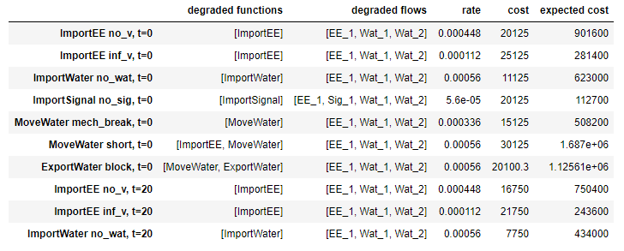
tabulate.py
tabulate.py
Display and export of simulation results as tables
-hist(mdlhist): Gives table of the history of model states.
-deghist(mdlhist, withstats): Gives table of all degraded functions and flows over time
-heatmaps(heatmap): Displays heatmap dictionary in tabular form
-simple/phase/sum/fullfmea():
Gives FMEA-like assessment of the effects of faults/scenarios and their probability and costs
Example Syntaxes:
reshists, diffs, summaries = rd.process.hists(mdlhists)
fullfmea = rd.tabulate.fullfmea(endclasses, summaries)
phasefmea = rd.tabulate.phasefmea(endclasses, app)

Slide 35
Activity: Visualize the results
Visualize the results
Show model graph
Show nominal performances
Show performances in a nominal scenario
Make a scenario-based fmea
Explore
How can you show only the parameters you want? Or change the formatting?
What does the behavior under other faults look like?
What other analyses can you perform with these results?

Slide 36
Further Reading and Links
Repository
https://github.com/DesignEngrLab/fmdtools
https://doi.org/10.5281/zenodo.3828048
Explanatory Paper
D. Hulse, H. Walsh, A. Dong, C. Hoyle, I.Y. Tumer, C. Kulkarni, K. Goebel, “fmdtools: A Fault Propagation Toolkit for Resilience Assessment in Early Design“ IJPHM. Submitted
Details on Fault Sampling
D. Hulse, C. Hoyle, I.Y. Tumer, K. Goebel, C. Kulkarni, “Temporal Fault Injection Considerations in Resilience Quantification.” ASME IDETC/CIE 2020, Design Automation Conference. IDETC2020-19287.

